Slide 1
2018 report figures/stats

Slide 2
Decker Time series
I need to grab updated fish data
Notes:
We took some sweep nets in September of 2017 for the aquatic veg study.
This is strange and obnoxious. I don’t know what to do about it.

Slide 3
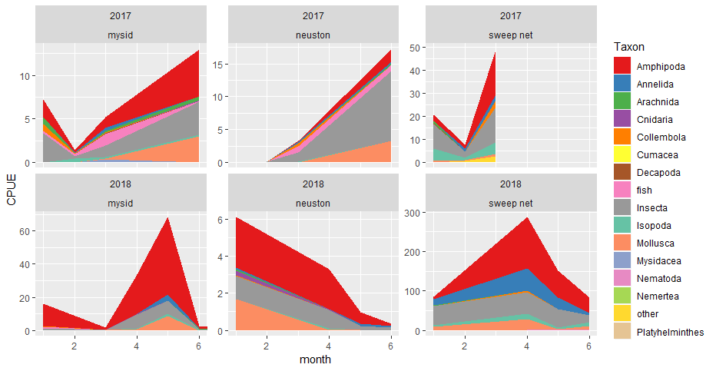
Decker Time series
Notes:
We took some sweep nets in September of 2017 for the aquatic veg study.
This is strange and obnoxious. I don’t know what to do about it.

Slide 4
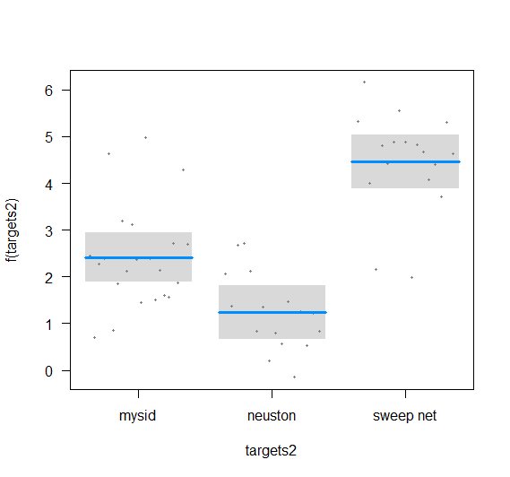
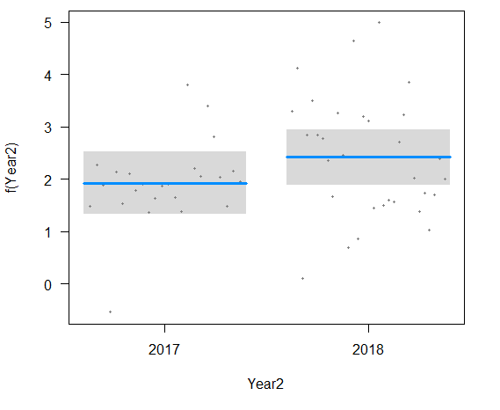
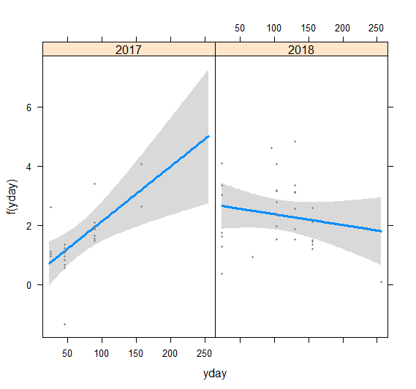
Decker Time series
log(tCPUE + 1) ~ Geartype + JulianDay*Year
 | Estimate | Std. Error | t value | Pr(>|t|)
(Intercept) | 0.284 | 0.481 | 0.591 | 0.557
Gear: neuston | -1.174 | 0.351 | -3.343 | 0.002 | **
Gear: sweep net | 2.042 | 0.341 | 5.985 | 0.000 | ***
Julian Day | 0.018 | 0.006 | 3.114 | 0.003 | **
Year | 2.458 | 0.619 | 3.968 | 0.000 | ***
Julian Day * Year2018 | -0.022 | 0.007 | -3.186 | 0.003 | **
Notes:
Without the interaction the Julian day is not significant

Slide 5
Channel/shallow time series
Our zooplankton samples aren’t done yet
EMP’s zooplankton data should be available by next week
Notes:
May want a quadratic for month.

Slide 6
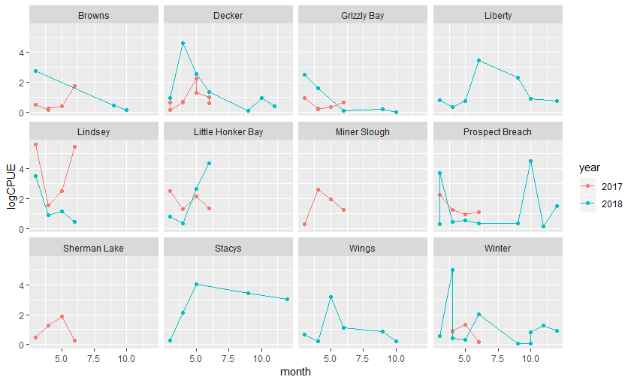
Channel/shallow time series - mysids
Notes:
May want a quadratic for month.

Slide 7
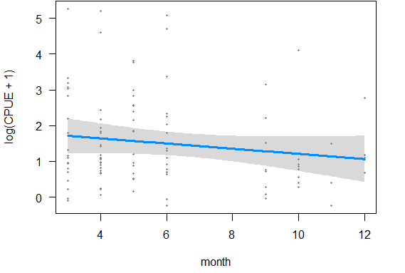
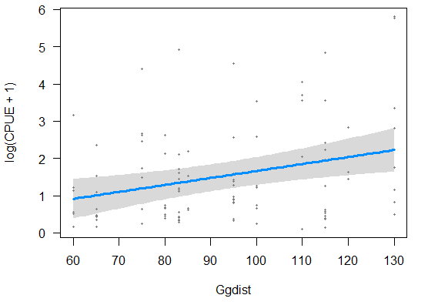
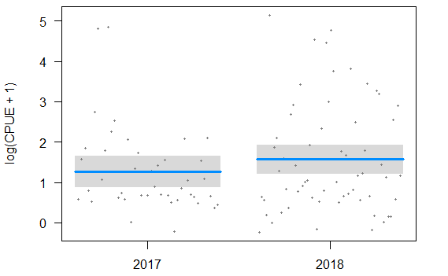
Channel/shallow time series - mysids
log(CPUE + 1) ~ month + Ggdist + year
 | Estimate | Std. Error | t value | Pr(>|t|)
(Intercept) | -0.151 | 0.640 | -0.236 | 0.814
month | -0.072 | 0.052 | -1.394 | 0.166
Ggdist | 0.019 | 0.006 | 3.070 | 0.003 | **
year2018 | 0.304 | 0.274 | 1.112 | 0.269
Notes:
May want a quadratic for month.

Slide 8
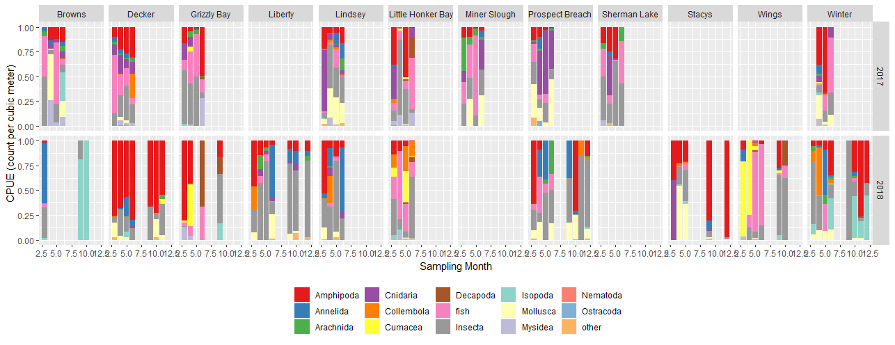
Channel/shallow time series - mysids
Notes:
May want a quadratic for month.

Slide 9
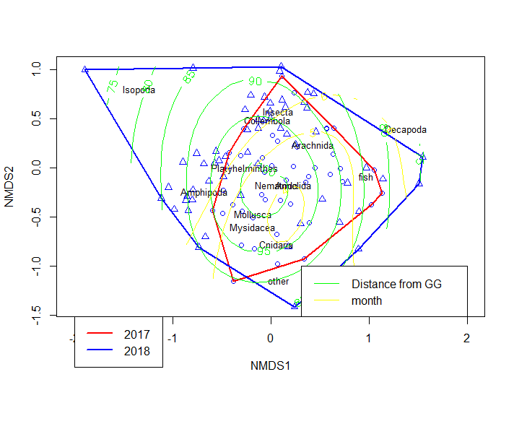
Channel/shallow time series - mysids
 | Df | SumsOfSqs | MeanSqs | F.Model | R2 | Pr(>F)
month | 1 | 0.9149 | 0.91491 | 4.2082 | 0.03712 | 0.001 | ***
Ggdist | 1 | 1.4958 | 1.49577 | 6.8798 | 0.06068 | 0.001 | ***
year | 1 | 0.9332 | 0.93318 | 4.2922 | 0.03786 | 0.003 | **
Residuals | 98 | 21.3065 | 0.21741 |  | 0.86435
Total | 101 | 24.6504 |  |  | 1

Slide 10
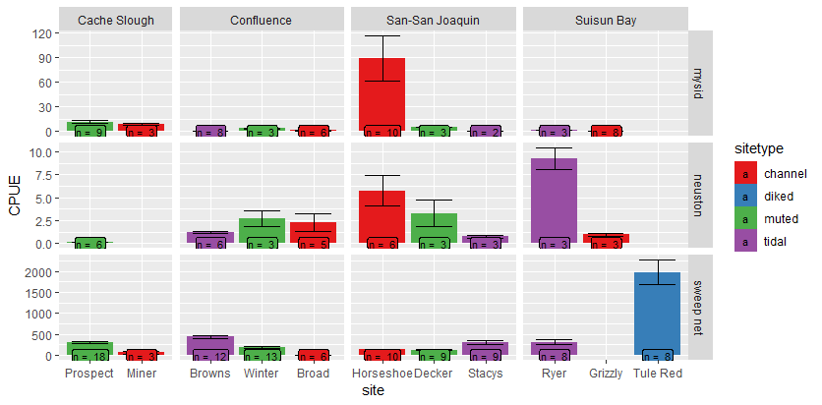
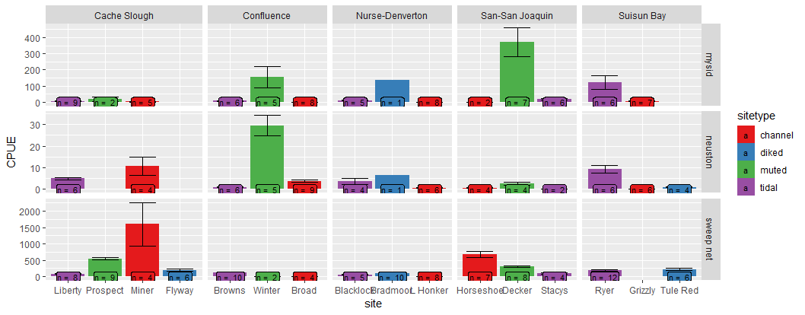
Macroinvertebrate blitz, total CPUE
2017
2018

Slide 11
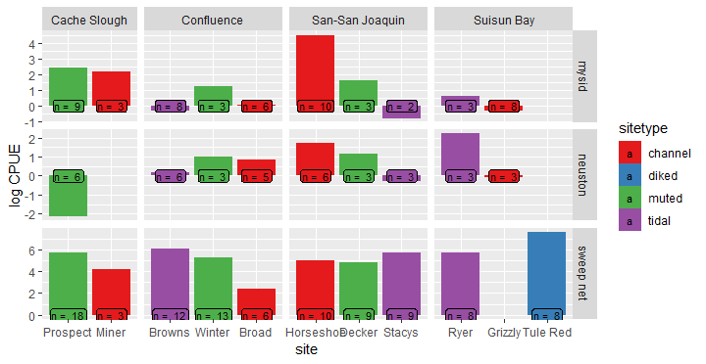
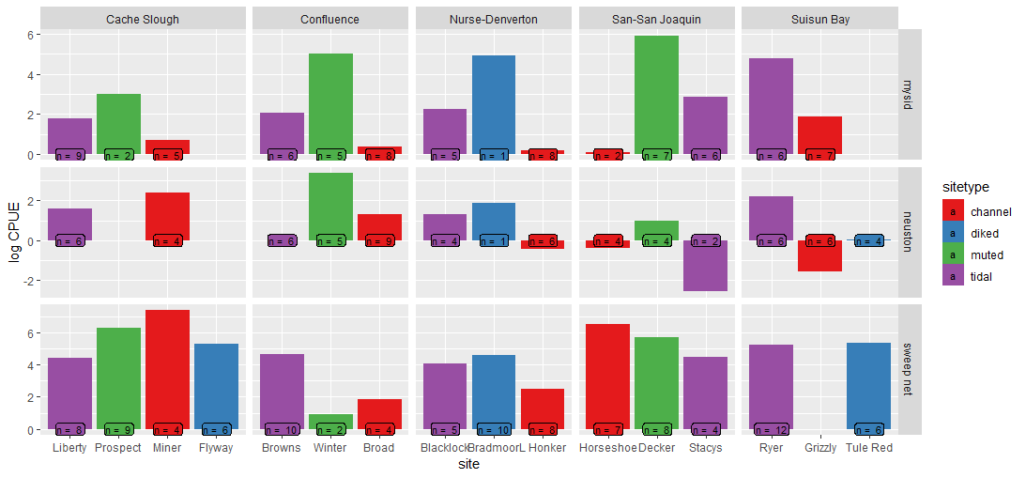
CPUE –log transformed
2017
2018

Slide 12
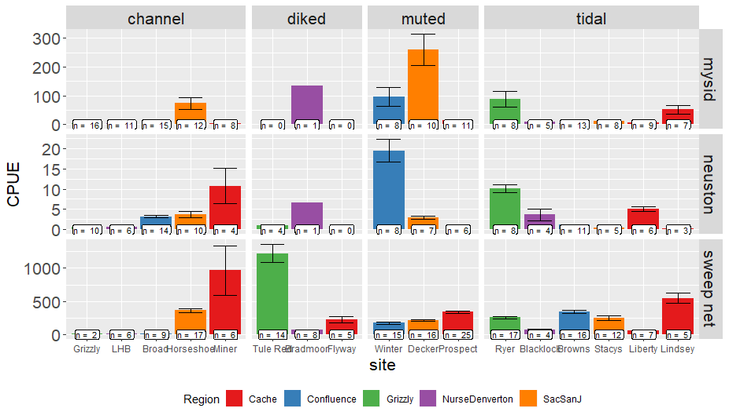
CPUE – both years together

Slide 13
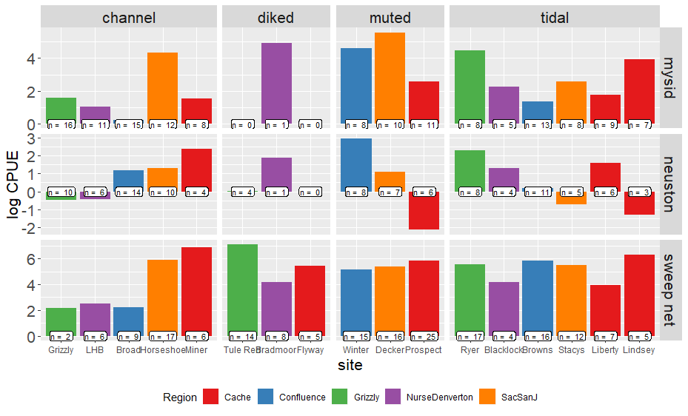
CPUE – log-transformed

Slide 14
Macroinvert blitz GLMM
Log(CPUE+1) ~ Gear + sitetype + Error(Site)
 | Estimate | Std. Error | df | t value | Pr(>|t|)
(Intercept: Channel, mysids) | 1.1574 | 0.223 | 15.7878 | 5.19 | <0.0001 | ***
Sitetype: diked | 1.0441 | 0.3741 | 21.252 | 2.791 | 0.01087 | *
Sitetype: muted | 1.0029 | 0.3307 | 10.8019 | 3.032 | 0.01162 | *
Sitetype: tidal | 0.4462 | 0.2935 | 11.6847 | 1.52 | 0.15498
Gear: neuston | -0.5131 | 0.1804 | 429.1981 | -2.844 | 0.00467 | **
Gear: sweep net | 2.7004 | 0.1613 | 435.1671 | 16.741 | < 0.0001 | ***
Post-hoc shows wetland sites have higher catch overall from channel sites, but wetlands are not different from each other.
Earlier analyses with AIC did not support use of Year or Region as predictor variables

Slide 15
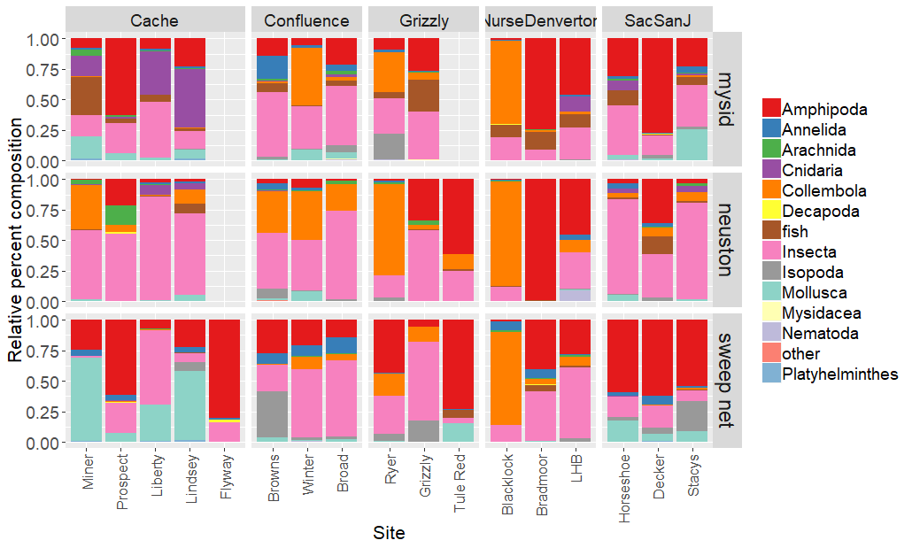
Macroinvert blitz
Notes:
Separate by year?

Slide 16
Macroinverts Multivariates
Permanova
 | Df | SumsOfSqs | MeanSqs | F.Model | R2 | Pr(>F)
Region | 4 | 6. 861 | 1.715 | 11.305 | 0.073 | 0.001 | ***
SiteType | 3 | 8.527 | 2.841 | 18.733 | 0.091 | 0.001 | ***
Habitat | 2 | 7.960 | 3.979 | 26.232 | 0.0849 | 0.001 | ***
site | 9 | 7.629 | 0.848 | 5.587 | 0.081 | 0.001 | ***
Residuals | 414 | 62.811 | 0.152 |  | 0.669
Total | 432 | 93.79 |  |  | 1

Slide 17
NMDS issues
I can’t get it to converge with two years of data at all the sites
One year at a time?
Average by site?
Just show NMDSs for the pairwise comparisons?
Show non-convergent solution?

Slide 18
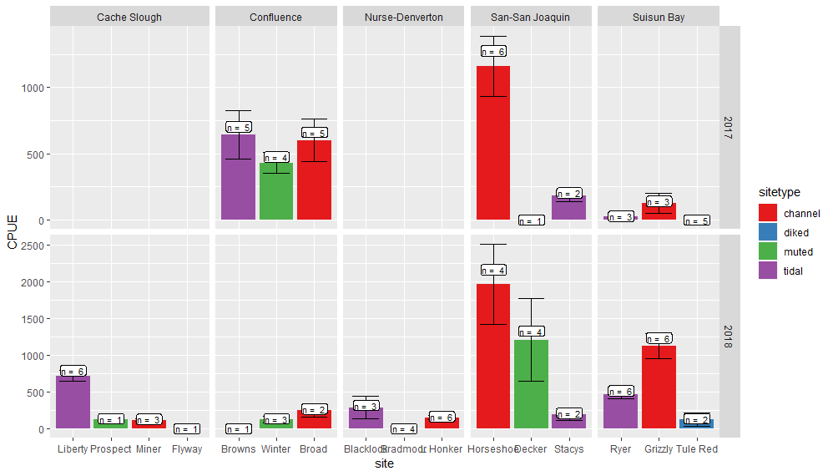
Clams
Since we changed the way we processed benthic samples this year, I’m planning on a separate analysis just of invasive clams

Slide 19
Clam logCPUE
LogCPUE ~ sitetype + Region + Year + error(site)
Best model via AICc
 | Estimate | Std. Error | df | t value | Pr(>|t|)
(Intercept) | 4.791 | 1.028 | 23.387 | 4.662 | 0.000 | ***
sitetypediked | -4.609 | 0.925 | 7.982 | -4.980 | 0.001 | **
sitetypemuted | -1.642 | 0.905 | 7.409 | -1.815 | 0.110
sitetypetidal | -0.891 | 0.673 | 6.502 | -1.323 | 0.230
Region2Confluence | -0.225 | 1.071 | 14.446 | -0.210 | 0.837
Region2Nurse-Denverton | -1.499 | 1.039 | 12.275 | -1.444 | 0.174
Region2San-San Joaquin | 0.464 | 1.028 | 11.876 | 0.451 | 0.660
Region2Suisun Bay | -0.018 | 0.963 | 9.218 | -0.019 | 0.985
Year22018 | 1.276 | 0.582 | 75.740 | 2.193 | 0.031 | *

Slide 20
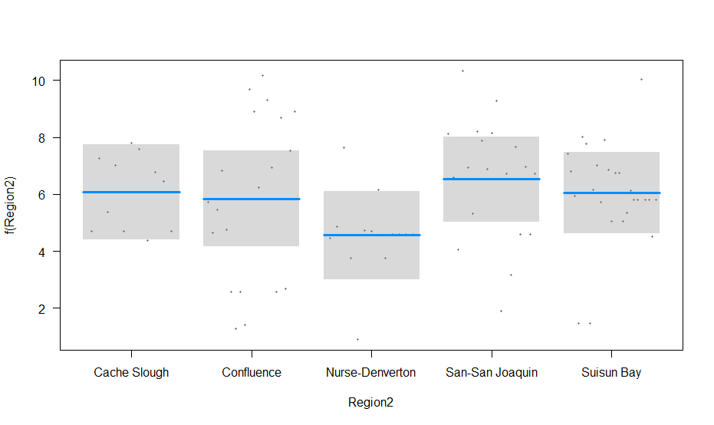
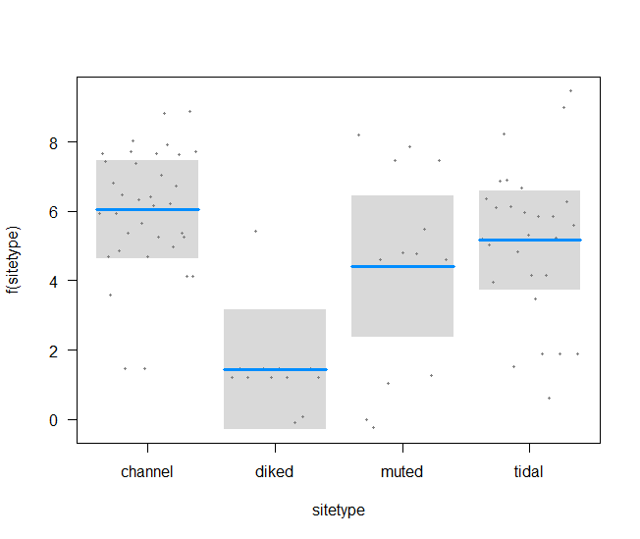
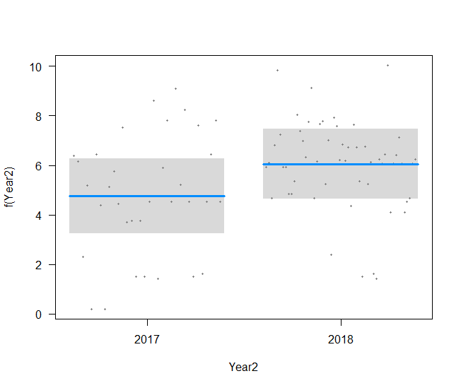
Clams
NS
A
A
A
B
B
A

Slide 21
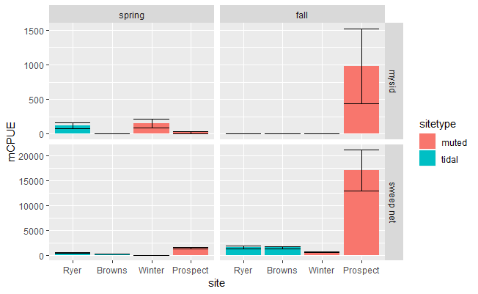
Spring versus Fall – macroinverts CPUE

Slide 22
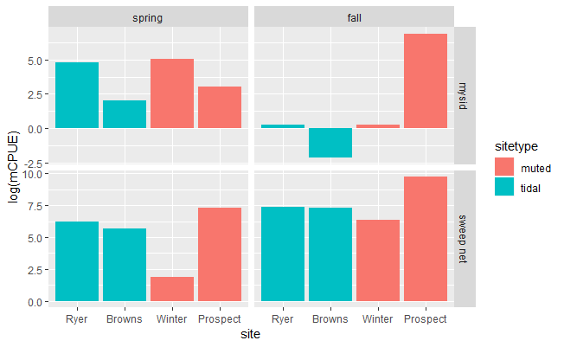
Log-transformed CPUE

Slide 23
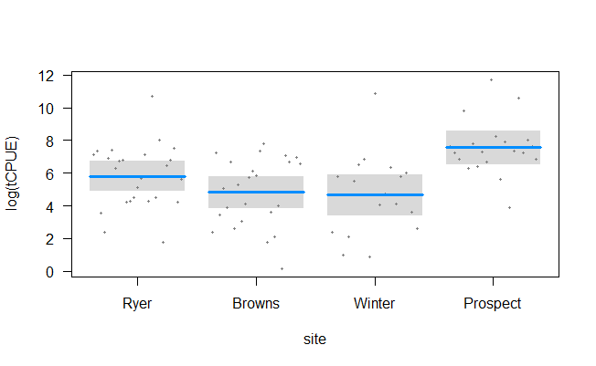
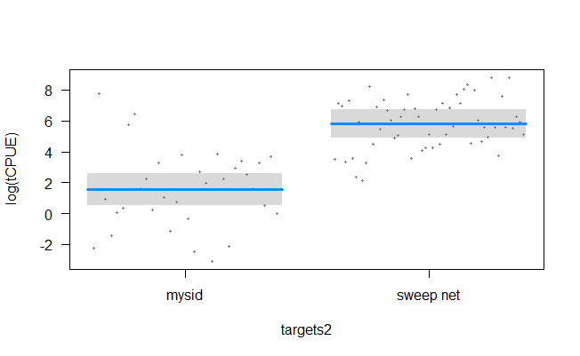
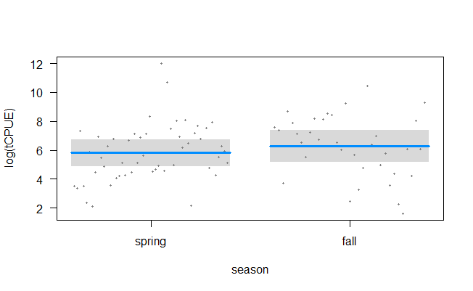
Spring versus Fall - macroinverts
 | Estimate | Std. Error | t value | Pr(>|t|)
(Intercept – mysid, ryer, spring) | 1.563 | 0.528 | 2.959 | 0.004 | **
Site: Browns | -0.999 | 0.589 | -1.698 | 0.093 | .
Site: Winter | -1.157 | 0.674 | -1.718 | 0.090 | .
Site: Prospect | 1.748 | 0.630 | 2.775 | 0.007 | **
Gear: sweep | 4.250 | 0.470 | 9.037 | 0.000 | ***
Season: fall | 0.471 | 0.466 | 1.011 | 0.315
C
B
A
AB
NS
B
A

Slide 24
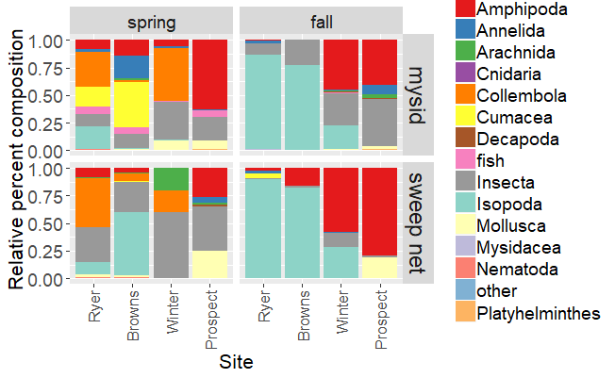
Spring v Fall multivariates

Slide 25
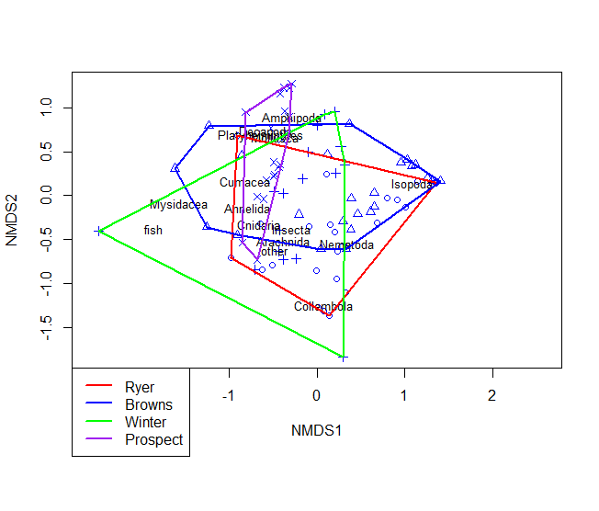
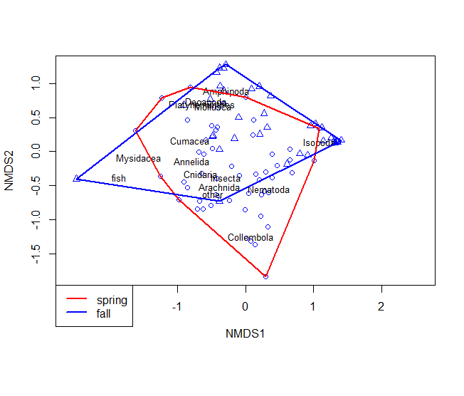
Spring v Fall PErmanova
 | Df | SumsOfSqs | MeanSqs | F.Model | R2 | Pr(>F)
Site | 3 | 5.6911 | 1.897 | 11.1194 | 0.24275 | 0.001 | ***
Gear | 1 | 0.7332 | 0.7332 | 4.2978 | 0.03128 | 0.002 | **
season | 1 | 3.2007 | 3.2007 | 18.7607 | 0.13652 | 0.001 | ***
Residuals | 81 | 13.8191 | 0.1706 |  | 0.58945
Total | 86 | 23.4442 |  |  | 1

Slide 26
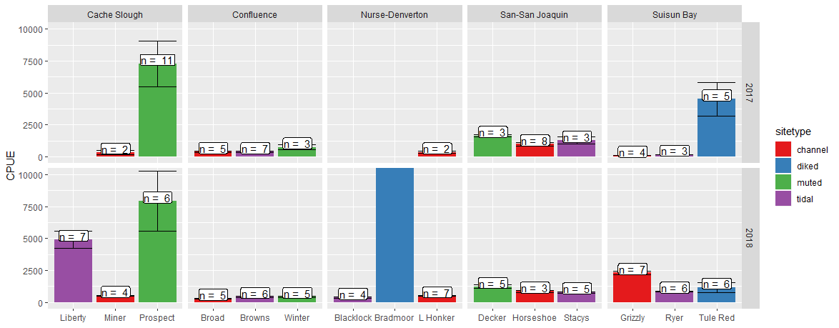
Zooplankton CPUE – spring blitz
CPUE = 135,198
N = 6
Notes:
We haven’t sorted all the fall samples yet.

Slide 27
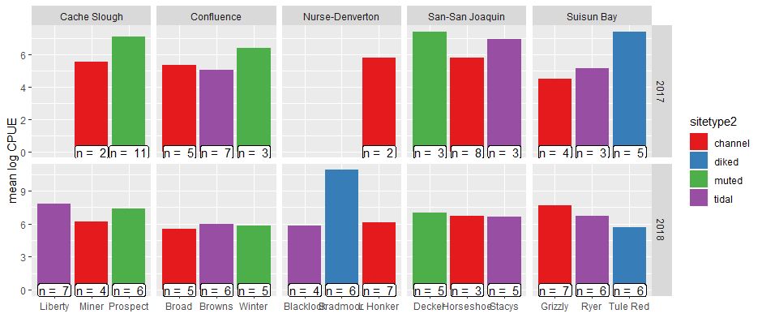
Zooplankton log cpue

Slide 28
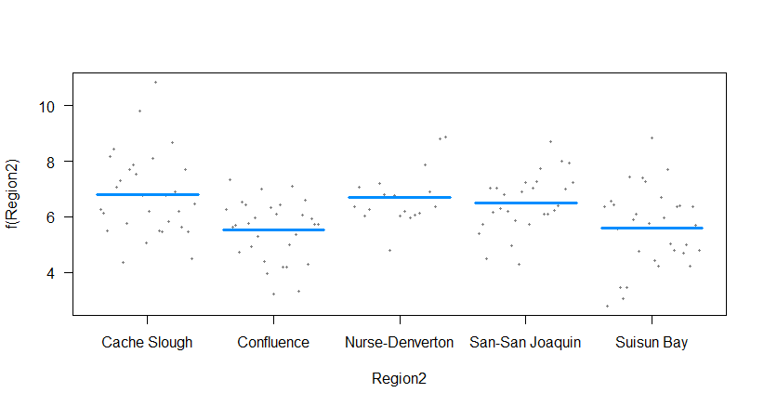
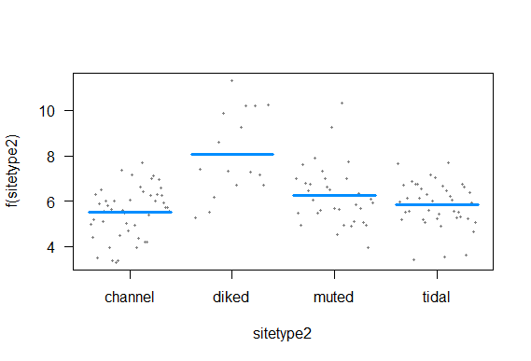
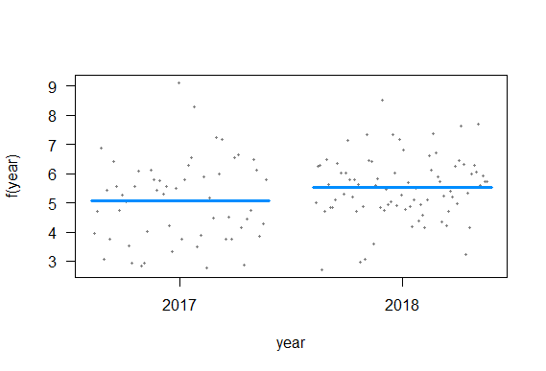
Log(CPUE)~ Region + sitetype + year + Error(site)
 | Estimate | Std. Error | df | t value | Pr(>|t|)
(Intercept – Cache, channel, 2017) | 6.345 | 0.788 | 7.414 | 8.057 | 0.000 | ***
Region - Confluence | -1.281 | 0.888 | 6.462 | -1.444 | 0.196
Region - Nurse-Denverton | -0.102 | 1.005 | 7.256 | -0.101 | 0.922
Region - San-San Joaquin | -0.283 | 0.892 | 6.584 | -0.317 | 0.761
Region - Suisun Bay | -1.200 | 0.983 | 6.651 | -1.221 | 0.264
Sitetype - diked | 2.560 | 1.009 | 6.623 | 2.537 | 0.041 | *
Sitetype - muted | 0.737 | 0.841 | 6.456 | 0.876 | 0.412
Sitetype - tidal | 0.330 | 0.695 | 6.739 | 0.475 | 0.650
year2018 | 0.451 | 0.245 | 124.870 | 1.839 | 0.068 | .
NS
B
NS
A
A
A
Notes:
I tried just looking at the 2018 data, and removing Bradmoor, but none of that helped.
Should I try just calanoid copepods?

Slide 29
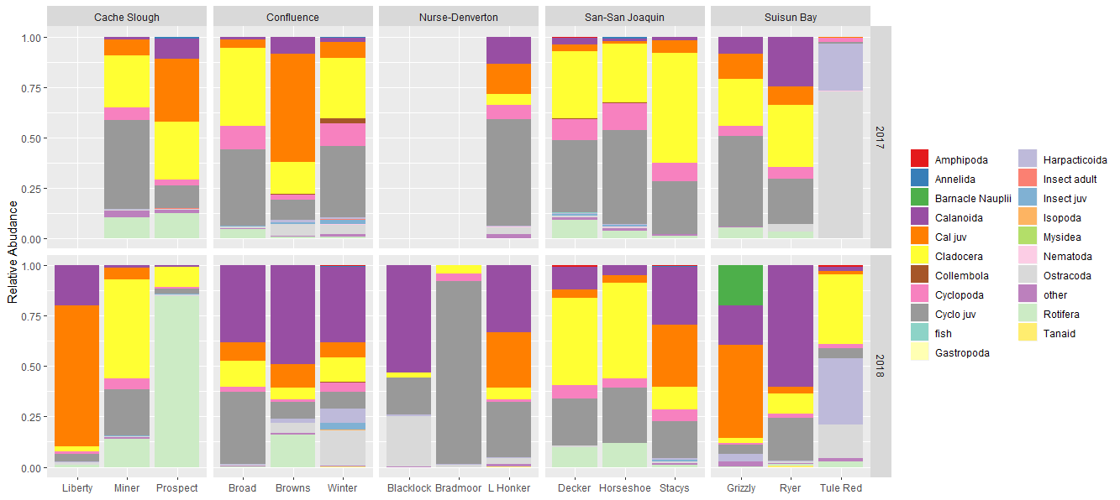
Zooplankton

Slide 30
Zooplankton Permanova
 | Df | SumsOfSqs | MeanSqs | F.Model | R2 | Pr(>F)
Region2 | 4 | 4.687 | 1.17174 | 7.8249 | 0.1566 | 0.001 | ***
sitetype2 | 3 | 4.3552 | 1.45173 | 9.6946 | 0.14551 | 0.001 | ***
year | 1 | 1.5705 | 1.57051 | 10.4878 | 0.05247 | 0.001 | ***
Residuals | 129 | 19.3172 | 0.14975 |  | 0.64542
Total | 137 | 29.9299 |  |  | 1
Notes:
No convergent solutions on NMDS

Slide 31
Pairwise comparisons
I need to add zooplankton and clam graphs to some of the comparisons
I want to add DWR’s yolo bypass toedrain data, maybe USFWS zooplankton data from Liberty.
Should I subset just “fish food” critters? It seems as though the more we learn the more we find all fish eat whatever is there.

Slide 32
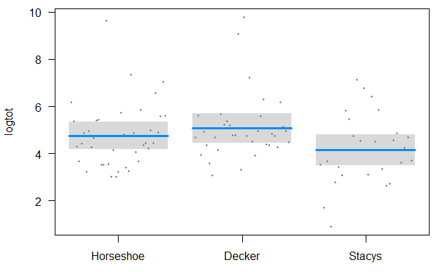
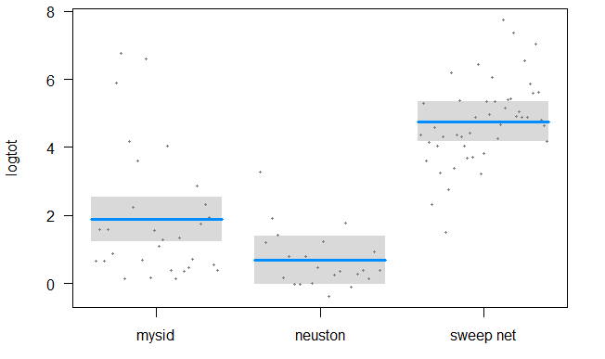
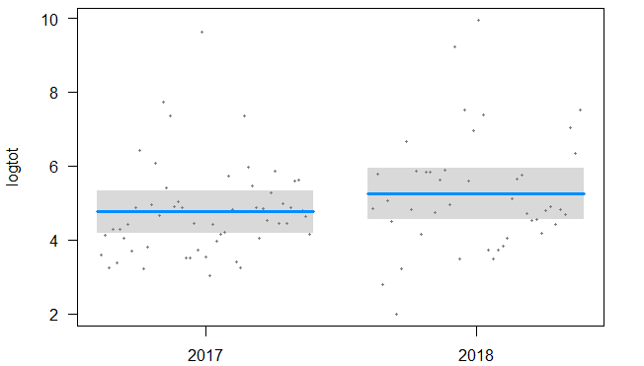
Stacy’s v Decker v Horseshoe bend
Macroinvert blitz
A
C
AB
B
A
B
ANOVA of log total CPUE
NS
 | Df | Sum Sq | Mean Sq | F value | Pr(>F)
site | 2 | 15.26 | 7.63 | 3.74 | 0.0274 | *
targets2 | 2 | 291.85 | 145.92 | 71.54 | <2e-16 | ***
Year2 | 1 | 5.46 | 5.46 | 2.675 | 0.1053
Residuals | 93 | 189.7 | 2.04

Slide 33
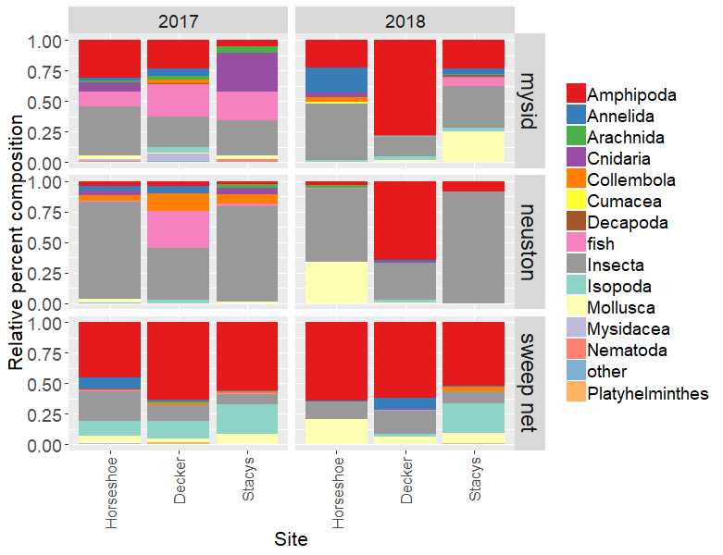
PERMANOVA
Stacy’s v Decker v Horseshoe bend
Macroinvert blitz
 | Df | SumsOfSqs | MeanSqs | F.Model | R2 | Pr(>F)
site | 2 | 1.46 | 0.73417 | 5.7648 | 0.081 | 0.001 | ***
Year | 1 | 0.70 | 0.70782 | 5.5579 | 0.039 | 0.004 | **
targets2 | 2 | 4.04 | 2.02407 | 15.8933 | 0.224 | 0.001 | ***
Residuals | 93 | 11.84 | 0.12735 |  | 0.655
Total | 98 | 18.06 |  |  | 1

Slide 34
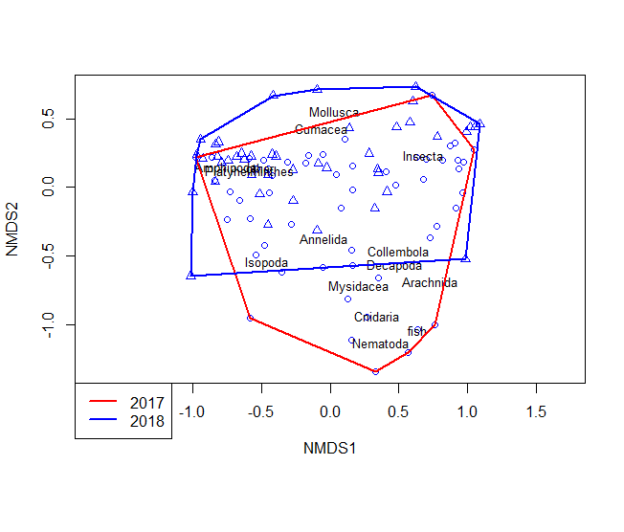
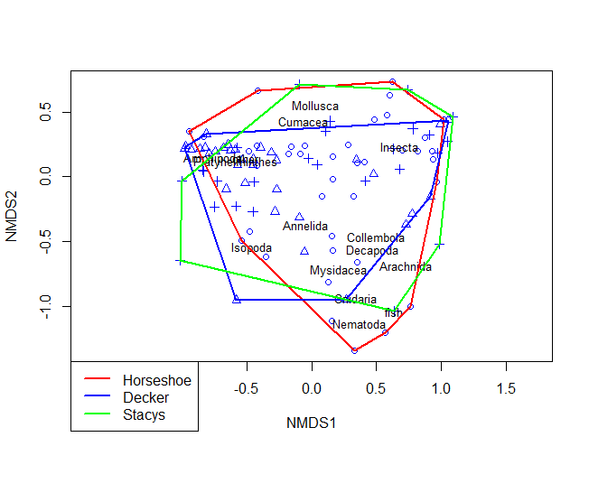
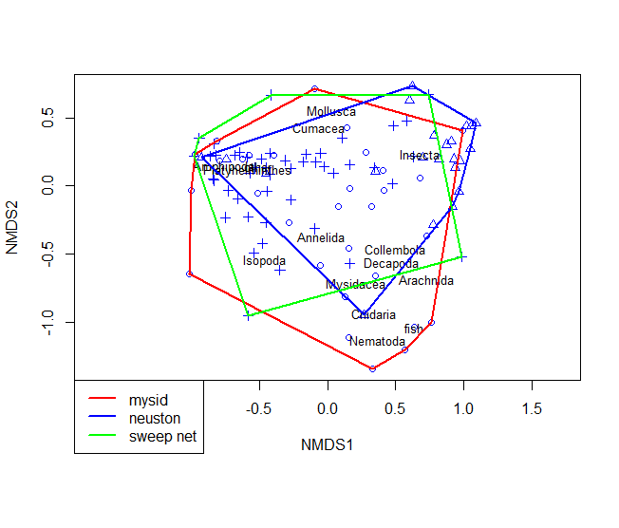
NMDS
Stacy’s v Decker v Horseshoe bend
Macroinvert blitz

Slide 35
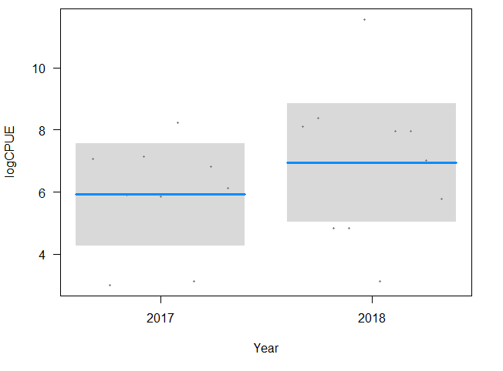
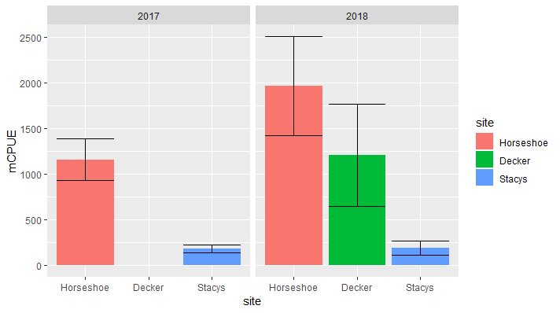
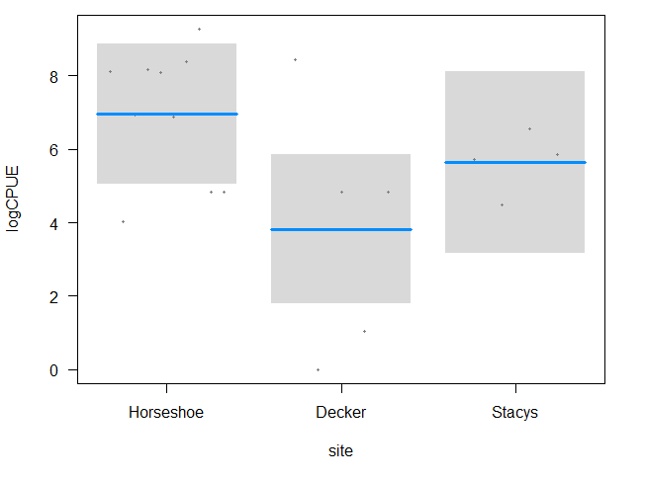
Clams
Stacy’s v Decker v Horseshoe bend
CLAMS anova
 | Df | Sum Sq | Mean Sq | F value | Pr(>F)
site | 2 | 24.89 | 12.443 | 2.423 | 0.122
Year | 1 | 4.47 | 4.465 | 0.87 | 0.366
Residuals | 15 | 77.02 | 5.134

Slide 36
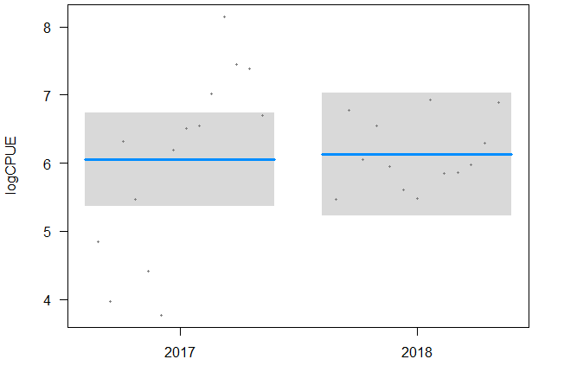
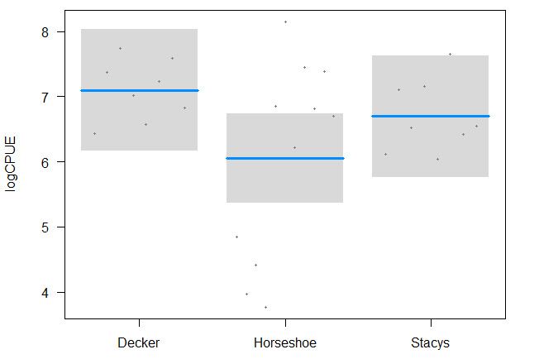
Zooplankton log(CPUE)~ site + year
Stacy’s v Decker v Horseshoe bend
Zooplankton Anova
 | Df | Sum Sq | Mean Sq | f value | Pr(>F)
site | 2 | 5.583 | 2.7915 | 2.356 | 0.117
year | 1 | 0.035 | 0.0355 | 0.03 | 0.864
Residuals | 23 | 27.252 | 1.1849

Slide 37
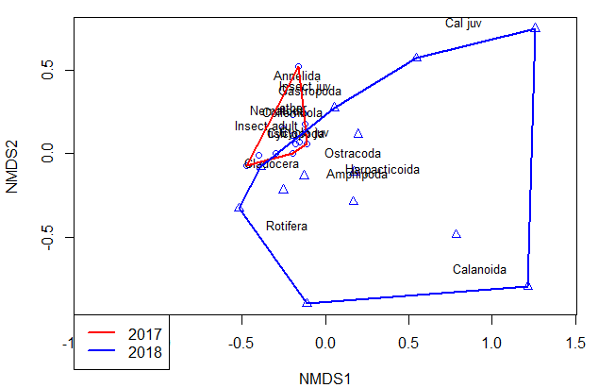
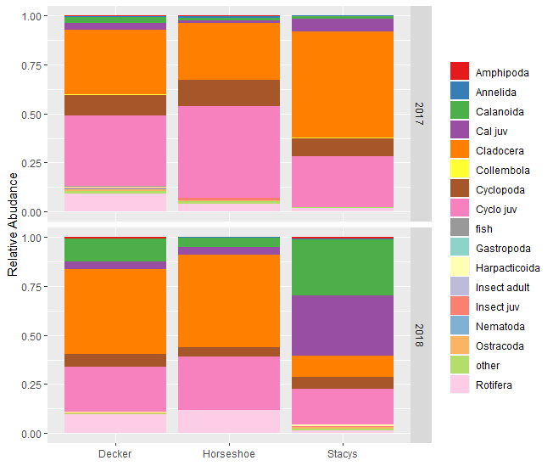
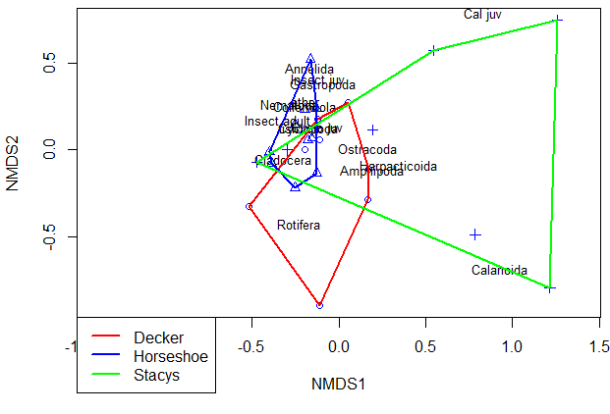
Zooplankton blitz Permanova and NMDS
Stacy’s v Decker v Horseshoe bend
NMDS stress = 0.1198
Zooplankton PERMANOVA
 | Df | SumsOfSqs | MeanSqs | F.Model | R2 | Pr(>F)
site | 2 | 0.563 | 0.281 | 3.464 | 0.204 | 0.001 | ***
year | 1 | 0.333 | 0.333 | 4.095 | 0.120 | 0.002 | **
Residuals | 23 | 1.868 | 0.081 |  | 0.676
Total | 26 | 2.764 |  |  | 1.000

Slide 38



Liberty v Prospect v Miner v Flyway
Macroinvert blitz
B
A
B
A
B
A
B
 | Df Sum Sq Mean Sq F | value | Pr(>F)
site | 3 50.09 16.70 | 9.057 | 2.87E-05 | ***
targets2 | 2 229.95 114.97 | 62.367 | < 2e-16 | ***
Year2 | 1 13.58 13.58 | 7.364 | 0.00806 | **
Residuals | 85 156.70 1.84
A
A

Slide 39

Liberty v Prospect v Miner v Flyway
Macroinvert blitz
Df SumsOfSqs MeanSqs F.Model | R2 Pr(>F)
site 3 3.7805 1.26016 9.0941 | 0.20452 0.001 | ***
Year 1 0.4823 0.48233 3.4808 | 0.02609 0.019 | *
targets2 2 2.4431 1.22156 8.8155 | 0.13217 0.001 | ***
Residuals 85 11.7784 0.13857 | 0.63721
Total 91 18.4843 | 1
---

Slide 40



Liberty v Prospect v Miner v Flyway
Macroinvert blitz

Slide 41

Liberty v Prospect v Miner v Flyway
Clams
Log(CPUE)~ site
 | Df | Sum Sq | Mean Sq | f value | Pr(>F)
site | 3 | 33.86 | 11.287 | 9.875 | 0.00656 | **
Residuals | 7 | 8 | 1.143
A
Tukey post-hoc
ABC
AB
 | diff | lwr | upr | p adj
Prospect-Liberty | -1.380 | -5.203 | 2.442 | 0.648
Miner-Liberty | -1.501 | -4.004 | 1.001 | 0.278
Flyway-Liberty | -6.203 | -10.025 | -2.380 | 0.004
Miner-Prospect | -0.121 | -4.207 | 3.965 | 1.000
Flyway-Prospect | -4.823 | -9.828 | 0.182 | 0.058
Flyway-Miner | -4.702 | -8.788 | -0.615 | 0.027
C

Slide 42


Zooplankton blitz log(CPUE) ~ site + year
Liberty v Prospect v Miner
zooplankton anova
 | Df | Sum Sq | Mean Sq | f value | Pr(>F)
site | 2 | 10.95 | 5.473 | 2.207 | 0.13
year | 1 | 0.64 | 0.643 | 0.259 | 0.615
Residuals | 26 | 64.48 | 2.48
Notes:
I need to add Yolo zoops for Flyway

Slide 43



Zooplankton blitz
Liberty v Prospect v Miner
NMDS stress = 0.155
 | Df | SumsOfSqs | MeanSqs | F.Model | R2 | Pr(>F)
site | 2 | 1.3683 | 0.68416 | 4.6267 | 0.24396 | 0.002 | **
year | 1 | 0.3958 | 0.39577 | 2.6764 | 0.07056 | 0.027 | *
Residuals | 26 | 3.8447 | 0.14787 |  | 0.68548
Total | 29 | 5.6088 |  |  | 1

Slide 44



Browns v Winter v Broad Slough
Macroinvert blitz
A
A
NS
B
B
 | Df | Sum Sq | Mean Sq | F value | Pr(>F)
site | 2 | 74.48 | 37.24 | 20.704 | 2.28E-08 | ***
targets2 | 2 | 182.1 | 91.05 | 50.622 | 2.38E-16 | ***
Year2 | 1 | 0.14 | 0.14 | 0.076 | 0.783
Residuals | 111 | 199.64 | 1.8
A
A

Slide 45

Browns v Winter v Broad Slough
Macroinvert blitz
permanova
 | Df | SumsOfSqs | MeanSqs F | F.Model | R2 | p
site | 2 | 3.2208 | 1.6104 | 10.1315 | 0.13156 | 0.001
Year | 1 | 0.8169 | 0.8169 | 5.1393 | 0.03337 | 0.001
targets2 | 2 | 2.8 | 1.40002 | 8.8079 | 0.11438 | 0.001
Residuals | 111 | 17.6435 | 0.15895 |  | 0.72069
Total | 116 | 24.4812 |  |  | 1

Slide 46



Macroinvert blitz

Slide 47



Grizzly v Ryer v Tule Red
Macroinvert blitz
C
C
A
A
B
B
 | Df | Sum Sq | Mean Sq | f value | Pr(>F)
site | 2 | 189.09 | 94.54 | 43.39 | <0.001 | ***
targets2 | 2 | 112.56 | 56.28 | 25.83 | <0.001 | ***
Year2 | 1 | 0.48 | 0.48 | 0.22 | 0.641
Residuals | 74 | 161.24 | 2.18
NS

Slide 48

Grizzly v Ryer v Tule Red
Macroinvert blitz
 | Df | SumsOfSqs | MeanSqs | F.Model | R2 | Pr(>F)
site | 2 | 5.969 | 2.984 | 16.879 | 0.269 | 0.001 | ***
Year | 1 | 0.387 | 0.387 | 2.189 | 0.017 | 0.063 | .
targets2 | 2 | 2.757 | 1.378 | 7.795 | 0.124 | 0.001 | ***
Residuals | 74 | 13.084 | 0.177 |  | 0.589
Total | 79 | 22.196 |  |  | 1.000

Slide 49



Grizzly v Ryer v Tule Red
Macroinvert blitz

